Slide 1
Numerical Computing in Python with Numpy and Scipy
Chris Cooling
ECRI Senior Teaching Fellow

Slide 2
Important Information on Marking your Attendance on Inkpath
I will show you a QR code at the end of the session allowing you to mark your attendance on Inkpath. Please do not mark your attendance until then. If you are a Postgraduate Research student, this is required for receiving your ECRI professional development credit for this course.

Slide 3
Learning Outcomes
Describe the key functionality and advantages of NumPy and SciPy
Utilise NumPy arrays to store and perform operations on data sets
Locate appropriate SciPy functions for a specific problem
Create basic programs using NumPy and SciPy to solve numerical problems

Slide 4
Course Materials
The course materials are stored in a GitHub repository
Instructions for using the materials are found in the readme
Links to open the course notebooks in Colab are at the bottom of the readme
The materials can also be downloaded and run locally
You can also star/fork the repository

Slide 5
ReCoDE
The RCDS team has curated a collection of annotated exemplar projects known as ReCoDE
These demonstrate core research computing and data science principles applied to real problems
Accompanied by detailed descriptions of how they work, and the design decisions taken.
Numpy and Scipy exemplars:
Euler-Maruyama Method
Solving Stochastic Differential Equations
Performs a numerical simulation using Numpy arrays
Incorporates Numpy into an object-oriented code
Using Convolutional Neural Networks to extract information from the Cosmic Dawn
Uses Numpy to store data to be uses by Tensorflow
Binary Classification of Patent Text Using Natural Language Processing
Uses NLP for classification problems
Uses Numpy to store and prepare data
A Multi-Channel GUI for Real-Time Data Display and Analysis
Stores and manipulated data in Numpy arrays
Notes:
Check Gotchas/gotchas.f90 for example of behaviour you might not expect.

Slide 6
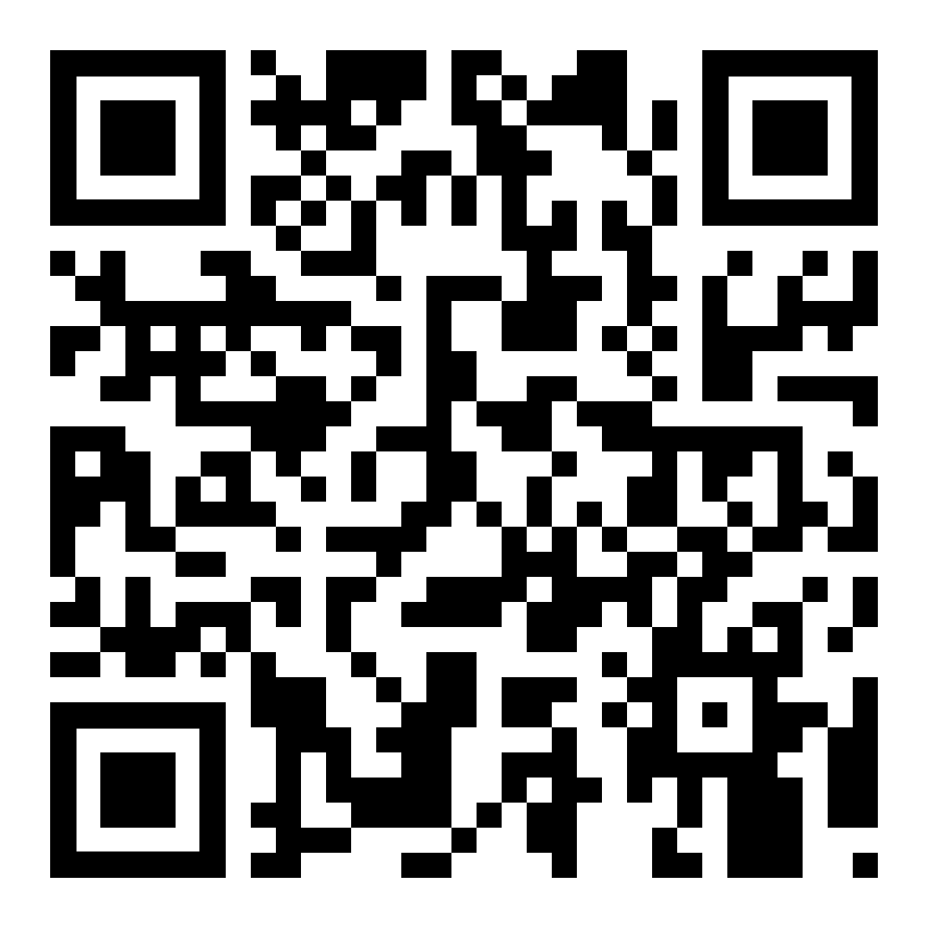
Please take 3 minutes to complete the evaluation
Once you’ve completed this course, please provide feedback
The link is https://tinyurl.com/feedback-rcds
You should also have received an email with this link
This helps us improve the class for future students

Slide 7

PRES 2025
Coming in 2025 - PRES is a national survey for research degree students
Find out more about the action we have taken in response to the previous PRES:
Postgraduate Research Experience Survey (PRES) | Current students | Imperial College London
Presentation Title
DD/MM/YYYY
Notes:
Remove after PRES closes

Slide 8
Thank you
Presentation Title
DD/MM/YYYY

